Slide 1

Principles of
Operating System
Memory Management

Slide 2

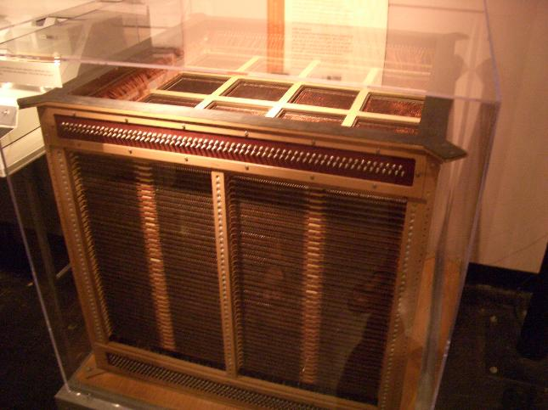
64kb of RAM

Slide 3
The Early Computer Memory
Since the ENIAC -- the first computer to be used commercially, went into service in 1945, there have been only three major memory formats.
In 1945, the ENIAC computer used thousands of vacuum tubes and had a memory of mercury and nickel wire delay lines. Between 1945 and 1954, delay lines, William tubes and magnetic drums was used as memory devices.
In 1952 at MIT, Jay Forrester invented the Core Memory. A core was a small ring of ferrite, a ferromagnetic ceramic material that could be magnetized in either of two directions. This unique feature of core enabled it to hold a bit of information, either a 1 or 0, depending on the direction of the magnetic charge. Core memory was used in about 95% of all computers by 1976.

Slide 4
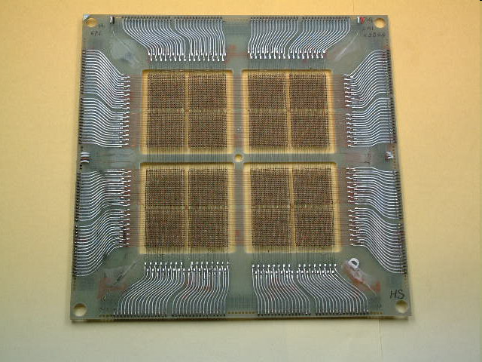
2048x8 bit Core Memory

Slide 5
In 1974, transistor (semiconductor) memory had become economical and the move to this type of memory began . Transistors led to integrated chips, which led to today's very highly integrated technology.
Today a typical memory contains 128 or 256 million bytes (8 bits) of information.

Slide 6
The Birth Of The Semiconductors
In 1968 a small company called Intel was startet and it's charter was to design, manufacture and market semiconductor memory components incorporating large scale integrated (LSI) technology. The company saw an untapped market in the replacement of computer core memories by producing low-cost, standardized circuits in high volume. Initial efforts were directed at bipolar and MOS memories.
The company's first successful product was the 3101 Schottky bipolar memory, a 64-bit high-speed static random access memory (RAM), introduced in 1969.

Slide 7
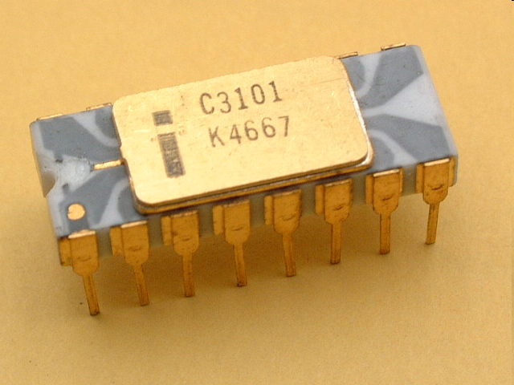
Early 3101 chip

Slide 8

Roadmap
Background
Contiguous Allocation
Paging
Segmentation
Segmentation with Paging

Slide 9
Background
Program must be brought into memory and placed within a process for it to be run.
Input queue: collection of processes on the disk that are waiting to be brought into memory to run the program.

Slide 10

Multistep Processing of a User Program
User programs go through several steps before being run.
  Address may be represented in different ways during these steps.
Source program
Symbolic
address
Relocatable
address
Absolute
address
Compiler
&linker
Loader

Slide 11
Example of Addresses Conversion
Source program
Logic address space
Physical address space
0
Load A data1
data1 3456
Load A 200
3456
BA=1000
Load A 200
3456
100
1100
Address mapping
Compile & link
200
1200

Slide 12
Binding of Instructions and Data to Memory
Address binding of instructions and data to memory addresses can happen at three different stages.
  Compile time: If you know at compile time where the process will reside in memory, then absolute code can be generated. Recompiling may be required.
  Load time: Must generate relocatable code if memory location is not known at compile time.
  Execution time: Binding delayed until run time if the process can be moved during its execution from one memory segment to another. Need hardware support for address maps (e.g., base and limit registers).

Slide 13
Logical vs. Physical Address Space
The concept of a logical address space that is bound to a separate physical address space is central to proper memory management.
  Logical address : generated by the CPU; also referred to as virtual address.
  Physical address : address seen by the memory unit.
Logical and physical addresses:
  are the same in compile-time and load-time address-binding schemes;
  differ in execution-time address-binding scheme.

Slide 14
Memory-Management Unit (MMU)
MMU: is a hardware device that maps virtual to physical address.
In MMU scheme, the value in the relocation register is added to every address generated by a user process at the time it is sent to memory.
  The user program deals with logical addresses;
  It never sees the real physical addresses;
  The memory mapping hardware converts logical addresses into physical addresses.

Slide 15

Example of Dynamic Relocation

Slide 16
Dynamic Loading
The size of a process is limited to the size of physical memory. To obtain better memory space utilization, dynamic loading is used.
With dynamic loading
  Routine is not loaded until it is called
  All routines are kept on disk in a relocatable load format.
The advantage is: an unused routine is never loaded.
  Useful when large amounts of code are needed to handle infrequently occurring cases.
No special support from the operating system is required implemented through program design.

Slide 17
Dynamic Linking
Linking postponed until execution time.
Stub: is a small piece of code, used to locate the appropriate memory-resident library routine.
  Stub replaces itself with the address of the routine, and executes the routine.
Operating system needed to check if routine is in processes’ memory address.
Dynamic linking is particularly useful for libraries.

Slide 18
Overlays
Object: to enable a process to be larger than the amount of memory allocated to it.
Idea: keep in memory only those instructions and data that are needed at any given time.
Implemented by user, no special support needed from operating system, programming design of overlay structure is complex.

Slide 19

Overlays for a Two-Pass Assembler
Assume that the sizes of these components are as follows:
Pass 1 70KB
Pass 2 80KB
Symbol table 20KB
Common routines 30KB
If only 150KB is available, what should we do?
Solution
Symbol
table
Common
routine
Pass 1
Overlay driver
Pass 2

Slide 20

Swapping
A process can be swapped temporarily out of memory to a backing store, and then brought back into memory for continued execution.

Slide 21
Swapping (cont.)
A variant of this swapping policy is used for priority-based scheduling algorithms.
  Roll out, roll in: if a higher-priority process arrives and wants service, the memory manager can swap out (roll out) the lower-priority process to load and execute the higher priority process (roll in).
Major part of swap time is transfer time; total transfer time is directly proportional to the amount of memory swapped.
Modified versions of swapping are found on many systems, i.e., UNIX, Linux, and Windows.

Slide 22
Roadmap
Background
Contiguous Allocation
Paging
Segmentation
Segmentation with Paging

Slide 23
Contiguous Allocation
Main memory is usually divided into two partitions:
  Resident operating system, usually held in low memory with interrupt vector.
  User processes then held in high memory.
In contiguous memory allocation, each process is contained in a single contiguous section of memory.

Slide 24
Memory Protection
How to protect the OS from user processes, and protect user processes from one another:
  Use relocation-register, which contains value of smallest physical address.
  Use limit register, which contains range of logical addresses.
  Each logical address must be less than the limit register.
  The MMU maps the logical address dynamically by adding the value in the relocation register.

Slide 25

Hardware Support for Relocation and Limit Registers

Slide 26
Contiguous Allocation (Cont.)
Multiple-partition allocation
  Hole: block of available memory; holes of various size are scattered throughout memory.
  When a process arrives, it is allocated memory from a hole large enough to accommodate it.
  Operating system maintains information about:
  a) allocated partitions b) free partitions (hole)
OS
OS
OS
OS
process 5
process 5
process 5
process 5
process 9
process 9
process 8
process 10
process 2
process 2
process 2
process 2

Slide 27
Dynamic Storage-Allocation Problem
How to satisfy a request of size n from a list of free holes.
  First-fit: Allocate the first hole that is big enough.
  Best-fit: Allocate the smallest hole that is big enough; must search entire list, unless ordered by size. Produces the smallest leftover hole.
  Worst-fit: Allocate the largest hole; must also search entire list. Produces the largest leftover hole.
First-fit and best-fit better than worst-fit in terms of speed and storage utilization.

Slide 28
Fragmentation
External Fragmentation: total memory space exists to satisfy a request, but it is not contiguous.
Internal Fragmentation: allocated memory may be slightly larger than requested memory; this size difference is memory internal to a partition, but not being used.

Slide 29
Fragmentation (cont.)
Reduce external fragmentation by compaction
  Shuffle memory contents to place all free memory together in one large block.
  Compaction is possible only if relocation is dynamic, and is done at execution time.

Slide 30
Roadmap
Background
Contiguous Allocation
Paging
Segmentation
Segmentation with Paging

Slide 31
Paging
Logical address space of a process can be noncontiguous; process is allocated physical memory whenever the latter is available.
  Divide physical memory into fixed-sized blocks called frames (size is power of 2, between 512 bytes and 8192 bytes).
  Divide logical memory into blocks of same size called pages.

Slide 32
Address Translation Scheme
Address generated by CPU is divided into:
  Page number (p) : used as an index into a page table which contains base address of each page in physical memory
  Page offset (d) : combined with base address to define the physical memory address that is sent to the memory unit
  For given logical address space 2^{m} and page size 2^{n}
page number
page offset
p
d
m - n
n

Slide 33

Address Translation Architecture

Slide 34

Paging Model of Logical and Physical Memory

Slide 35

Paging Example (cont.)
Page size: 4 bytes
Physical memory: 32bytes
Logical address 0 is page 0,
offset 0.
logical
address
physical address
0
5*4+0=20
3
5*4+3=23
4
6*4+0=24

Slide 36
Fragmentation Problem
Paging itself is a form of dynamic relocation.
  Every logical address is bound by the paging hardware to some physical address.
  Using paging is similar to using a table of base (or relocation) registers, one for each frame of memory.
Using paging scheme, there is no external fragmentation, but may be some internal fragmentation.

Slide 37
Page Size
Pages typically are between 4KB and 8KB, and some system support even lager page sizes.
Each page-table entry is usually 4 bytes long, but that size can vary as well.
  A 32-bit entry can point to one of 2³² physical page frames.
  If a frame is 4KB, then a system with 4-byte entries can address 2⁴⁴ bytes of physical memory.

Slide 38

Free Frames
Before allocation
After allocation

Slide 39
Feature of Paging
An important aspect of paging is the clear separation between the user’s view of memory and the actual physical memory.
  The difference between the user’s view of memory and the actual physical memory is reconciled by the address-translation hardware.

Slide 40
Implementation of Page Table
Page table is kept in main memory.
  Page-table base register (PTBR) points to the page table.
  Page-table length register (PTLR) indicates size of the page table.
In this scheme every data/instruction access requires two memory accesses.
  One for the page table and one for the data/instruction.
The two memory access problem can be solved by the use of a special fast-lookup hardware cache called associative memory or translation look-aside buffers (TLBs)

Slide 41
Associative Memory
Associative memory – parallel search
Address translation (A´, A´´)
  If A´ is in associative register, get frame # out.
  Otherwise get frame # from page table in memory
Page #
Frame #

Slide 42

Paging Hardware With TLB

Slide 43
Effective Memory-Access Time
The percentage of times that a particular page number is found in the TLB is called the hit ratio.
  80% hit ratio means that we find the desired page number in the TLB 80 percent of the time.
If it takes 20ns to search the TLB, and 100ns to access memory, then the effective memory-access time is:
0.8*120+0.2*220=140ns

Slide 44
Effective Memory-Access Time (cont.)
Associative Lookup = ε time unit
Assume memory cycle time is 1 ms
Hit ratio = α
Effective Access Time (EAT)
EAT = (1 + ε) α + (2 + ε)(1 – α) = 2 + ε – α

Slide 45
Memory Protection
Memory protection implemented by associating protection bit with each frame.
Valid-invalid bit attached to each entry in the page table:
  “valid” indicates that the associated page is in the process’ logical address space, and is thus a legal page.
  “invalid” indicates that the page is not in the process’ logical address space.

Slide 46

Valid (v) or Invalid (i) Bit In A Page Table

Slide 47
Page Table Structure
Hierarchical Paging
Hashed Page Tables
Inverted Page Tables

Slide 48
Hierarchical Page Tables
Most modern computer systems support a large logical address space, in which the page table becomes excessively large.
Issue: we would not want to allocate the page table contiguously in main memory.
Solution: Break up the logical address space into multiple page tables.
A simple technique is a two-level page table.

Slide 49

Two-Level Page-Table Scheme

Slide 50
Two-Level Paging Example
A logical address (on 32-bit machine with 4K page size) is divided into:
  a page number consisting of 20 bits.
  a page offset consisting of 12 bits.
Since the page table is paged, the page number is further divided into:
  a 10-bit page number.
  a 10-bit page offset.
Thus, a logical address is as follows:
where p₁ is an index into the outer page table, and p₂ is the displacement within the page of outer page table.
page number
page offset
p₁
p₂
d
10
10
12

Slide 51

Address-Translation Scheme
Address-translation scheme for a two-level 32-bit paging architecture

Slide 52


Three-level Paging Scheme

Slide 53
Hashed Page Tables
Common in address spaces > 32 bits.
The virtual page number is hashed into a page table. This page table contains a chain of elements hashing to the same location.
Virtual page numbers are compared in this chain searching for a match.
  If a match is found, the corresponding physical frame is extracted.

Slide 54

Hashed Page Table

Slide 55
Inverted Page Table
One entry for each real page of memory.
Each entry consists of the virtual address of the page stored in that real memory location, with information about the process that owns that page.
Only one page table is in the system, and it has only one entry for each page of physical memory.

Slide 56

Inverted Page Table Architecture

Slide 57
Feature of Inverted Page Table
Although this scheme decreases the amount of memory needed to store each page table, it increases the amount of time needed to search the table when a page reference occurs.
Can use hash table to limit the search to one —— or at most a few —— page-table entries.

Slide 58
Shared Pages
Shared code
  One copy of read-only (reentrant) code shared among processes (i.e., text editors, compilers, window systems).
  Shared code must appear in same location in the logical address space of all processes.
Private code and data
  Each process keeps a separate copy of the code and data.
  The pages for the private code and data can appear anywhere in the logical address space.

Slide 59
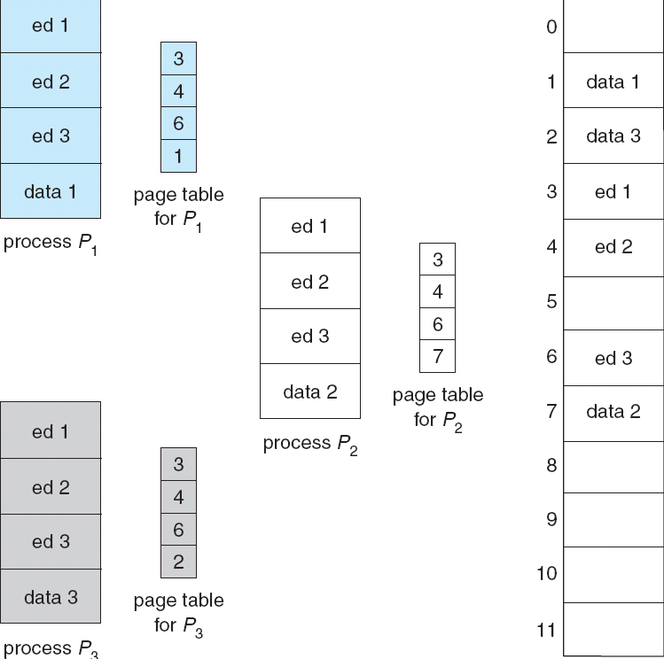
Shared Pages Example

Slide 60
Roadmap
Background
Contiguous Allocation
Paging
Segmentation
Segmentation with Paging

Slide 61
Segmentation
Memory-management scheme that supports user view of memory.
A program is a collection of segments.
A segment is a logical unit such as:
  main program, procedure, function, method, object, local variables, global variables, common block, stack, symbol table, arrays

Slide 62

User’s View of a Program

Slide 63
Logical View of Segmentation
1
1
4
2
3
4
2
3
user space
physical memory space

Slide 64
Segmentation Architecture
Logical address consists of a two tuple:
<segment-number, offset>
Segment table: maps two-dimensional logic addresses to one-dimensional physical addresses.
Each table entry has:
  Base: contains the starting physical address where the segments reside in memory.
  Limit: specifies the length of the segment.

Slide 65
Segmentation Architecture (cont.)
Segment-table base register (STBR) points to the segment table’s location in memory.
Segment-table length register (STLR) indicates number of segments used by a program;
  segment number s is legal if s < STLR.

Slide 66

Segmentation Hardware

Slide 67

Example of Segmentation

Slide 68

Segmentation Architecture (cont.)
Advantages of segmentation:
  the association of protection with the segments.
  the sharing of code or data.

Slide 69
Roadmap
Background
Contiguous Allocation
Paging
Segmentation
Segmentation with Paging

Slide 70
Segmentation with Paging
Paging the segments can solve problems of external fragmentation and lengthy search times.
Solution differs from pure segmentation in that the segment-table entry contains not the base address of the segment, but rather the base address of a page table for this segment.

Slide 71

Address Translation Scheme

Slide 72

Segmentation with Paging – Intel 386
The Intel 386 uses segmentation with paging for memory management with a two-level paging scheme.

Slide 73
Keystone
Definition of logical and physical address
Different kinds of algorithms address mapping
  Continuous memory allocation
  Paging
  Segmentation
  Segmentation with paging

Slide 74
Homework
Given memory partitions of 100K, 500K, 200K, 300K, and 600K (in order), how would each of the First-fit, Best-fit, and Worst-fit algorithms place processes of 212K, 417K, 112K, and 426K (in order)? Which algorithm makes the most efficient use of memory?
Consider a logical address space of eight pages of 1024 words each, mapped onto a physical memory of 32 frames.
  a. How many bits are there in the logical address?
  b. How many bits are there in the physical address?

Slide 75
Homework
Consider the following segment table:
Segment Base Length
0 219 600
1 2300 14
2 90 100
3 1327 580
4 1952 96
What are the physical addresses for the following logical addresses?
  a.0,430
  b.1,10
  c.2,500
  d.3,400
  e.4,112

Slide 76
Principles of
Operating System
End of Memory Management

